Slide 1
A more circular strategy for ‘Het Warenhuis’
Implementing principles of circular economy: Repurpose, Recycle & Reuse while fostering Recognition

Slide 2
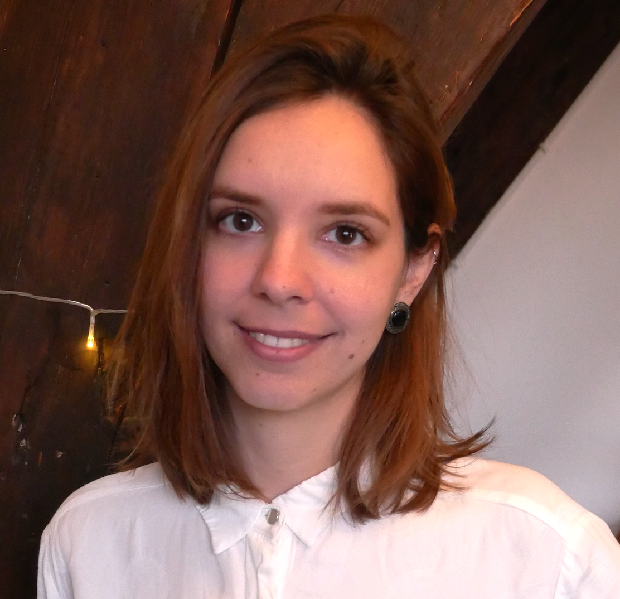
Meet the team
Michael Wellens
Katarina Foss-Solbrekk
Celia Serguera Perez
Sebastiaan Olislagers

Slide 3
Contents
Meet our client
Defining the problem
Using circular economy
Our strategic advice (4R)
Repurpose
Recycle
Reuse
Recognition
Next steps for Het Warenhuis
Final conclusion and recommendations
Towards a more circular thrift shop: The why, how and what.

Slide 4
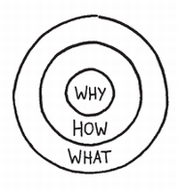
Why: To help ‘Het Warenhuis’ establish more sustainable practices and save money
How: By using ideas of Circular Economy
What: Creating a strategic advice for Het Warenhuis

Slide 5
Meet our Client
Thrift shop in Leiden
Three locations
Subsidised to collect materials
A social workplace for people with a distance to the labour market
A place to develop, learn and grow

Slide 6
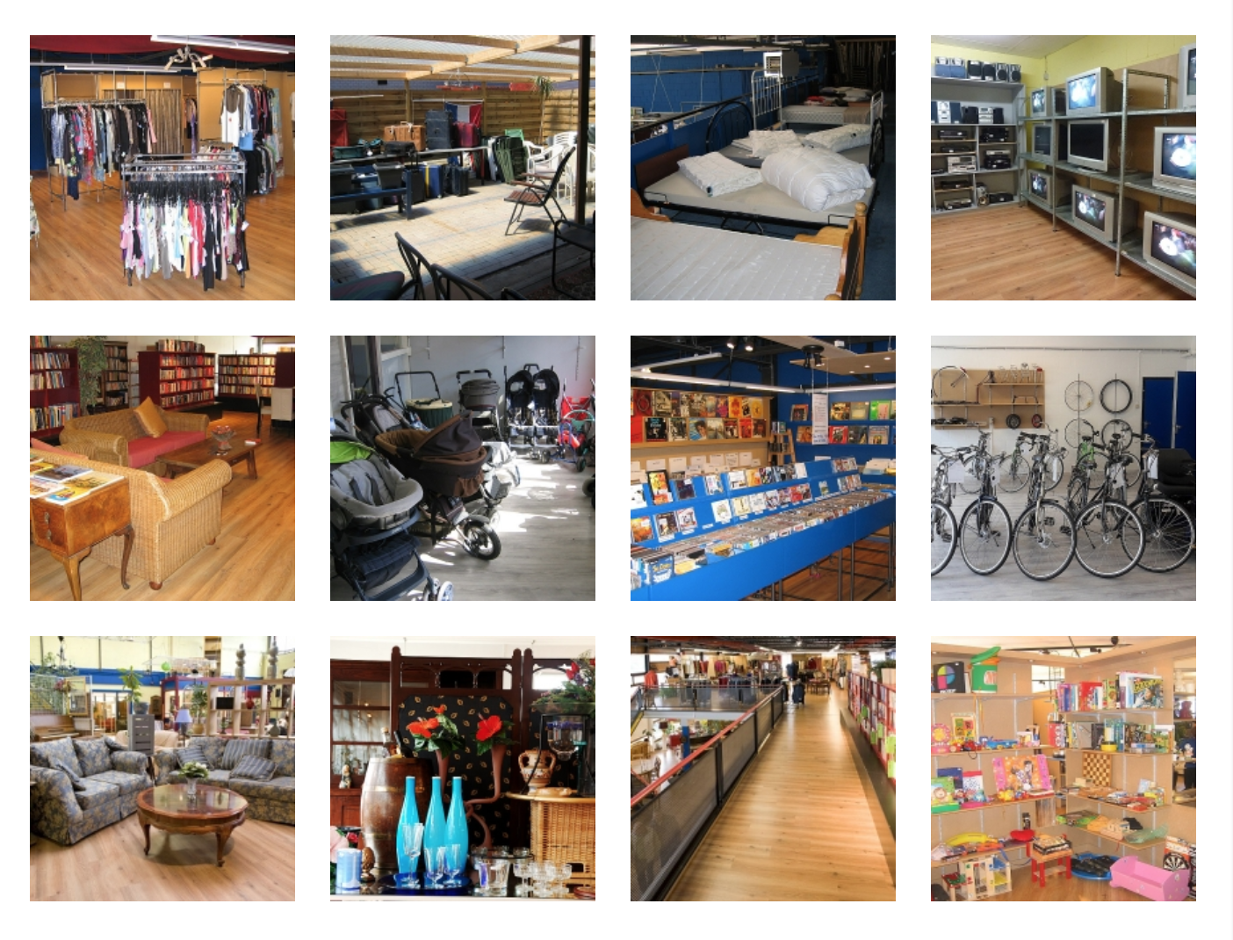

Slide 7
Defining the Problem

Slide 8
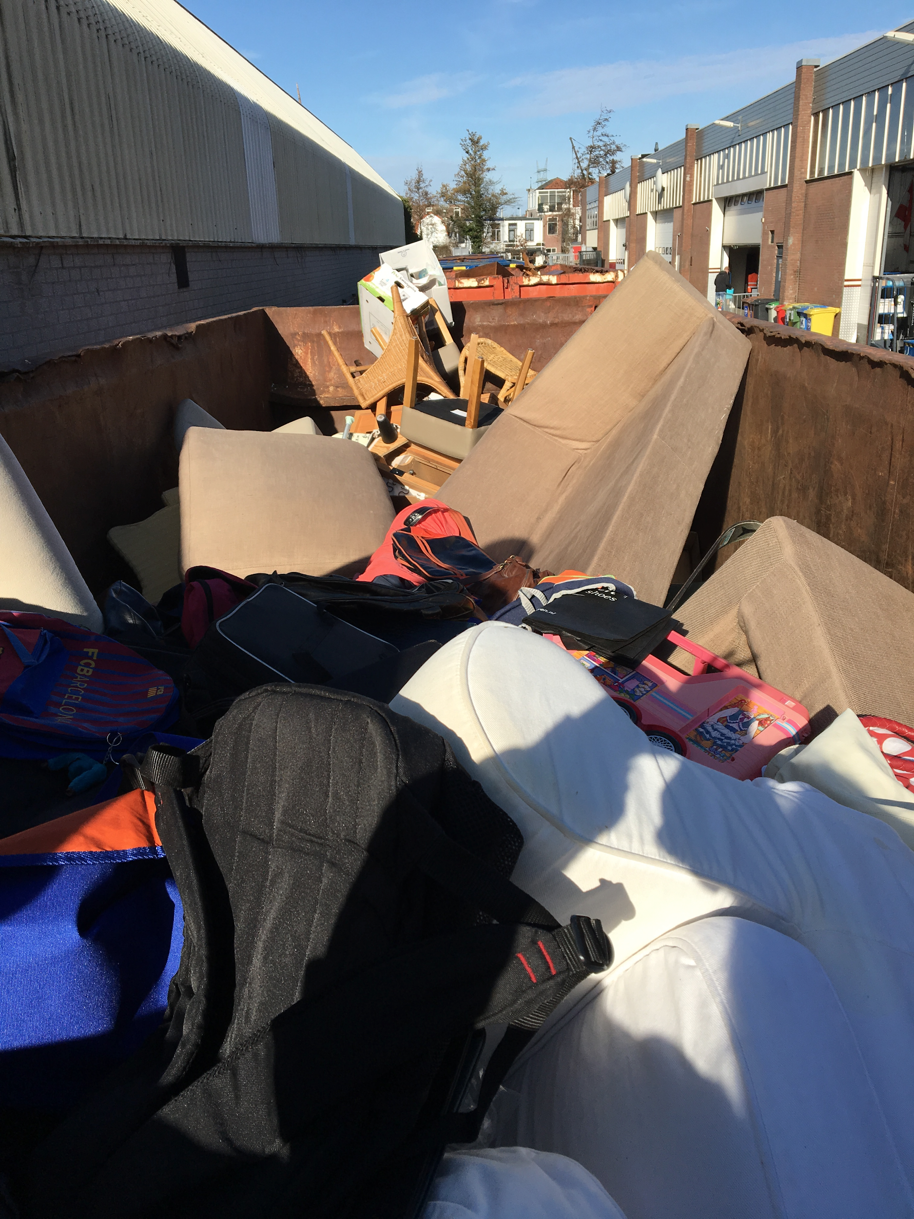
Mixed Waste
In 2018 mixed garbage costs Het Warenhuis ~€100,000
Growing problem: → 2016: €67,635 → 2017: €78,486)[1]
Consists of furniture, plastics, unsellable products (i.e. broken, damaged)
Most potential with couches
€12,645 from couches
Significant amount of plastics
Notes:
Sources:
Financial Statement 2017, Het Warenhuis, http://www.kringloopwarenhuis.nl/images/pdf/StichtingKringloopbedrijfhetWarenhuisjrk-2017.pdf.

Slide 9
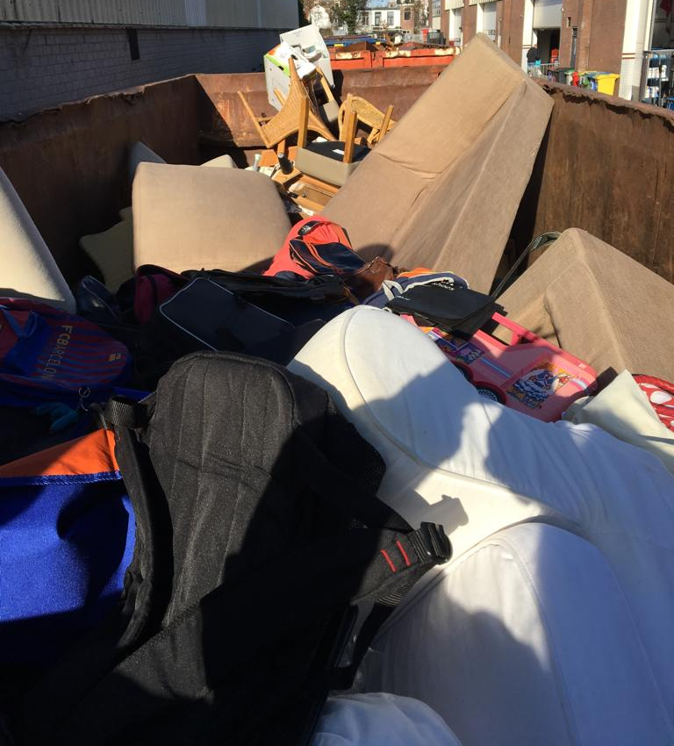
Chairs
Couch
Toys
Backpack
Notes:
Picture showing contents of materials/products found in the mixed waste.

Slide 10
Circular
Applying
Economy

Slide 11
Circular, not Linear
Linear Economic Model: Can be defined as a “take, make and dispose” approach, where the environment is seen as a waste reservoir (Su et al., 2013)
Circular Economy: Prioritizes the conservation of natural resources and reusability of materials and/or products (Circular Academy, 2016, para. 4; Dupont-Iglis, 2015)

Slide 12
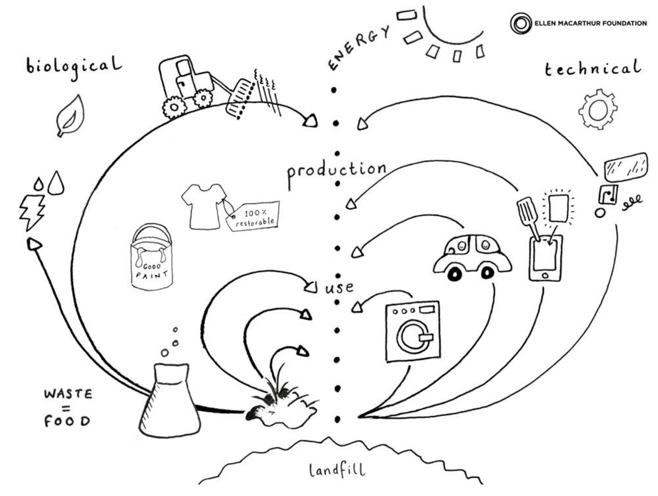
Butterfly Diagram
CE → a regenerative system that aims...
To positively maximize the economic, environmental and social development (Circular Academy, 2016, para. 4; Dupont-Iglis, 2015)
To significantly reduce resource and energy waste (among others) by slowing down, narrowing and, if possible, closing the material loops (Geissdoerfer et al., 2017, 579).
Het Warenhuis’ project is focused mainly on the ‘technical’ cycle. Narrowing material loops and thus, prolonging material/product life cycle (stock management)
Notes:
Source: https://www.ellenmacarthurfoundation.org/circular-economy/infographic

Slide 13
Our Strategic Advice (4Rs)
R-hierarchies allow significant resource retention over multiple product life cycles (e.g. recycle, redesign, refurbish, repair, etc.)
For our advice we decided to implement, in terms of material and products, their:
Recycling (most applied measure of CE)
Reusage
Repurpose
Recognition, as a non traditional R in CE
… striving for a more complete application of the CE in het Warenhuis. (Reike, Vermeulen, and Witjes, 2018)

Slide 14
Repurpose
Paper

Slide 15
Paper
Separate container for paper:
Mostly consists of broken books
Paper waste is currently sent for recycling:
Does not end up in landfill
Produces less greenhouse gas emissions
The obtained recycle fiber is sustainable for the making of new paper
Alternatives → Repurpose:
Convert books into paper bags (instead of plastic bags)
Price tags (for the store)
Donate to schools
Notes:
Virtanen, Y., & Nilsson, S. (2013). Environmental impacts of waste paper recycling. Routledge.

Slide 16
Recycle
Plastic

Slide 17
Plastic
Tackling plastic as an issue has several sides to it
Pros:
Substantial component of the mixed waste
Relatively easy to recycle, if processed correctly
Cons:
Willingness/incentive for companies to collect plastic (costs)
Relatively lightweight material so quite some manpower needs to be invested to collect a significant amount to recycle

Slide 18
Plastic out of the mixed waste
Price of disposing a tonne of plastic waste is on average 25%-50% of the costs of disposing a tonne mixed waste
Different kinds of plastics require separate collection:
Thermoplastic (EPS separate), Thermosetting, Elastomere
Sorting out the plastics → costs labour and money
The money needed to provide this labour is can be paid with the money saved by separating plastic waste from the mixed waste.
Labour can be provided at low cost as het warenhuis is a social workplace. Increasing the amount of this low skilled labour is seen as a benefit for Het Warenhuis, enlarging its function as a social workplace contributing to society.
An accurate cost benefit calculation based on data is still missing, due to a lack of data at Het Warenhuis

Slide 19
Reuse Repurpose Recycle Recognition
Couches

Slide 20
Couches: Problem 1
A lot of couches… [1]
Every year 1931 couches are collected
Only 382 are sold → 1549 couches are thrown away
Why [2]?
Dirty condition: ~1000
Damaged condition: ~500
Notes:
Sources:
Het Warenhuis Financial administration: Couches
Direct measurement at intake

Slide 21
Couches: Problem 2 [1]
Selling couches makes €21,815 a year
€47.09 per two-seat and €77.46 per three-seat (including processing fee)
Processing fee makes €1,927 a year
€4.77 per two-seat and €5.61 per three-seat
Throwing couches away costs €12,645 a year
Garbage cost: €6.16 per two-seat and €7.25 per three-seat
Notes:
Sources:
Het Warenhuis Financial administration: Couches

Slide 22
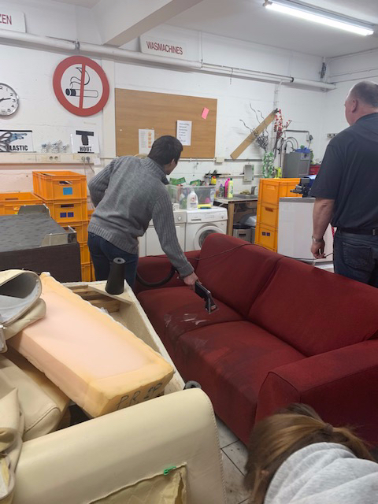
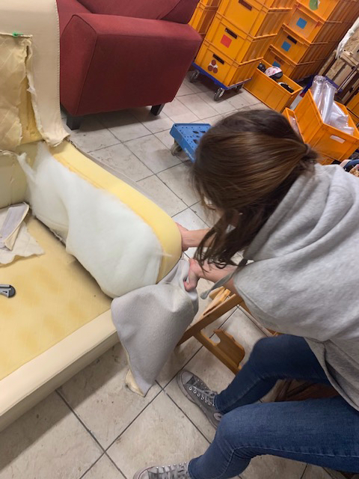
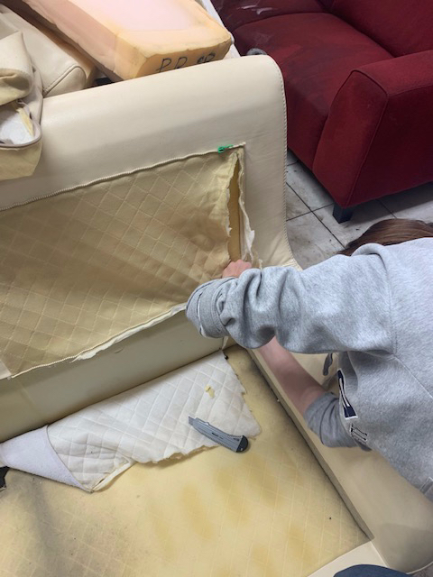
Couches: Solutions
Clean
Reuse: If not ‘shop-worthy:’ sell to students! (at a discount)
Dismantle

Slide 23
Couches: Cleaning
Takes ~30 min. of labor + machine costs (+ water & soap)
If it works:
Garbage cost is saved (€6.16 for a two-seat couch)
Processing fee is earned (€4.77 for a two-seat couch)
Problem: deep stains can not be cleaned.
Conclusion: this solution is couch dependent and should therefore be tested.

Slide 24
Couches: Reusing
(Student Survey) N = 35
61% of Leiden student sample size would buy a 2nd hand couch
73% said price important
76% noted that stains were a decisive factor
80+% were interested in couch delivery services
47% wish to buy a 2nd hand couch via social media
32% are interested in a warehouse sale.
= Trying to make Leiden students more circular….
Notes:
For all survey results, see: https://www.surveymonkey.com/results/SM-C259XKZNV/

Slide 25
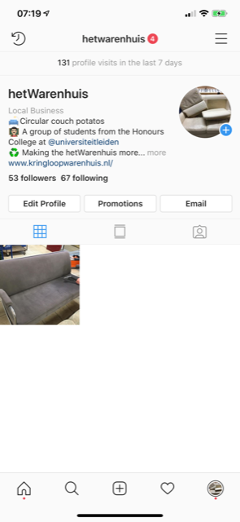
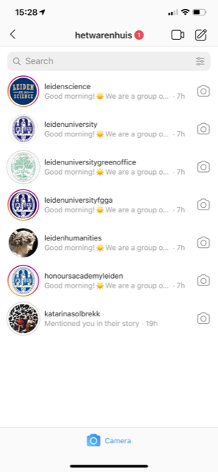
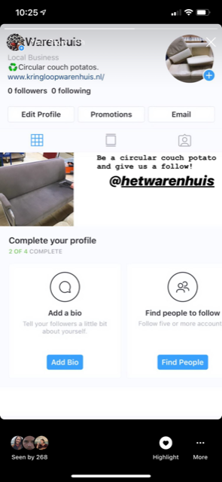
Connecting Het Warenhuis with Students
Social Media
Created their Instagram and Facebook presence.
Warehouse Sales
Working towards including het Warenhuis in the newsletter and information sent by Leiden University to incoming students in August.
-
-

Slide 26
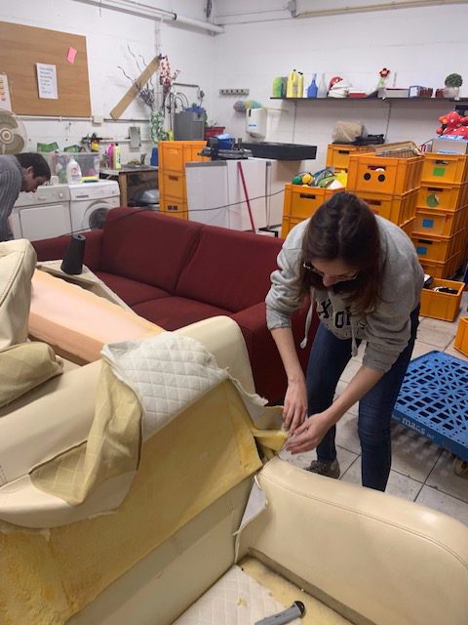
Couches: Recycling
If a couch is not sellable: de-construct!
Some testing: it takes 2 persons (with no practical experience) + 20~60 minutes to deconstruct a couch into: [1]
Wooden components;
Cover (polyester or leather);
Foam.
...These materials may be sold or re-used to create other saleable goods (e.g. leather jacket, filling for cushions...)
Notes:
Sources:
Small concept-of-proof tests

Slide 27
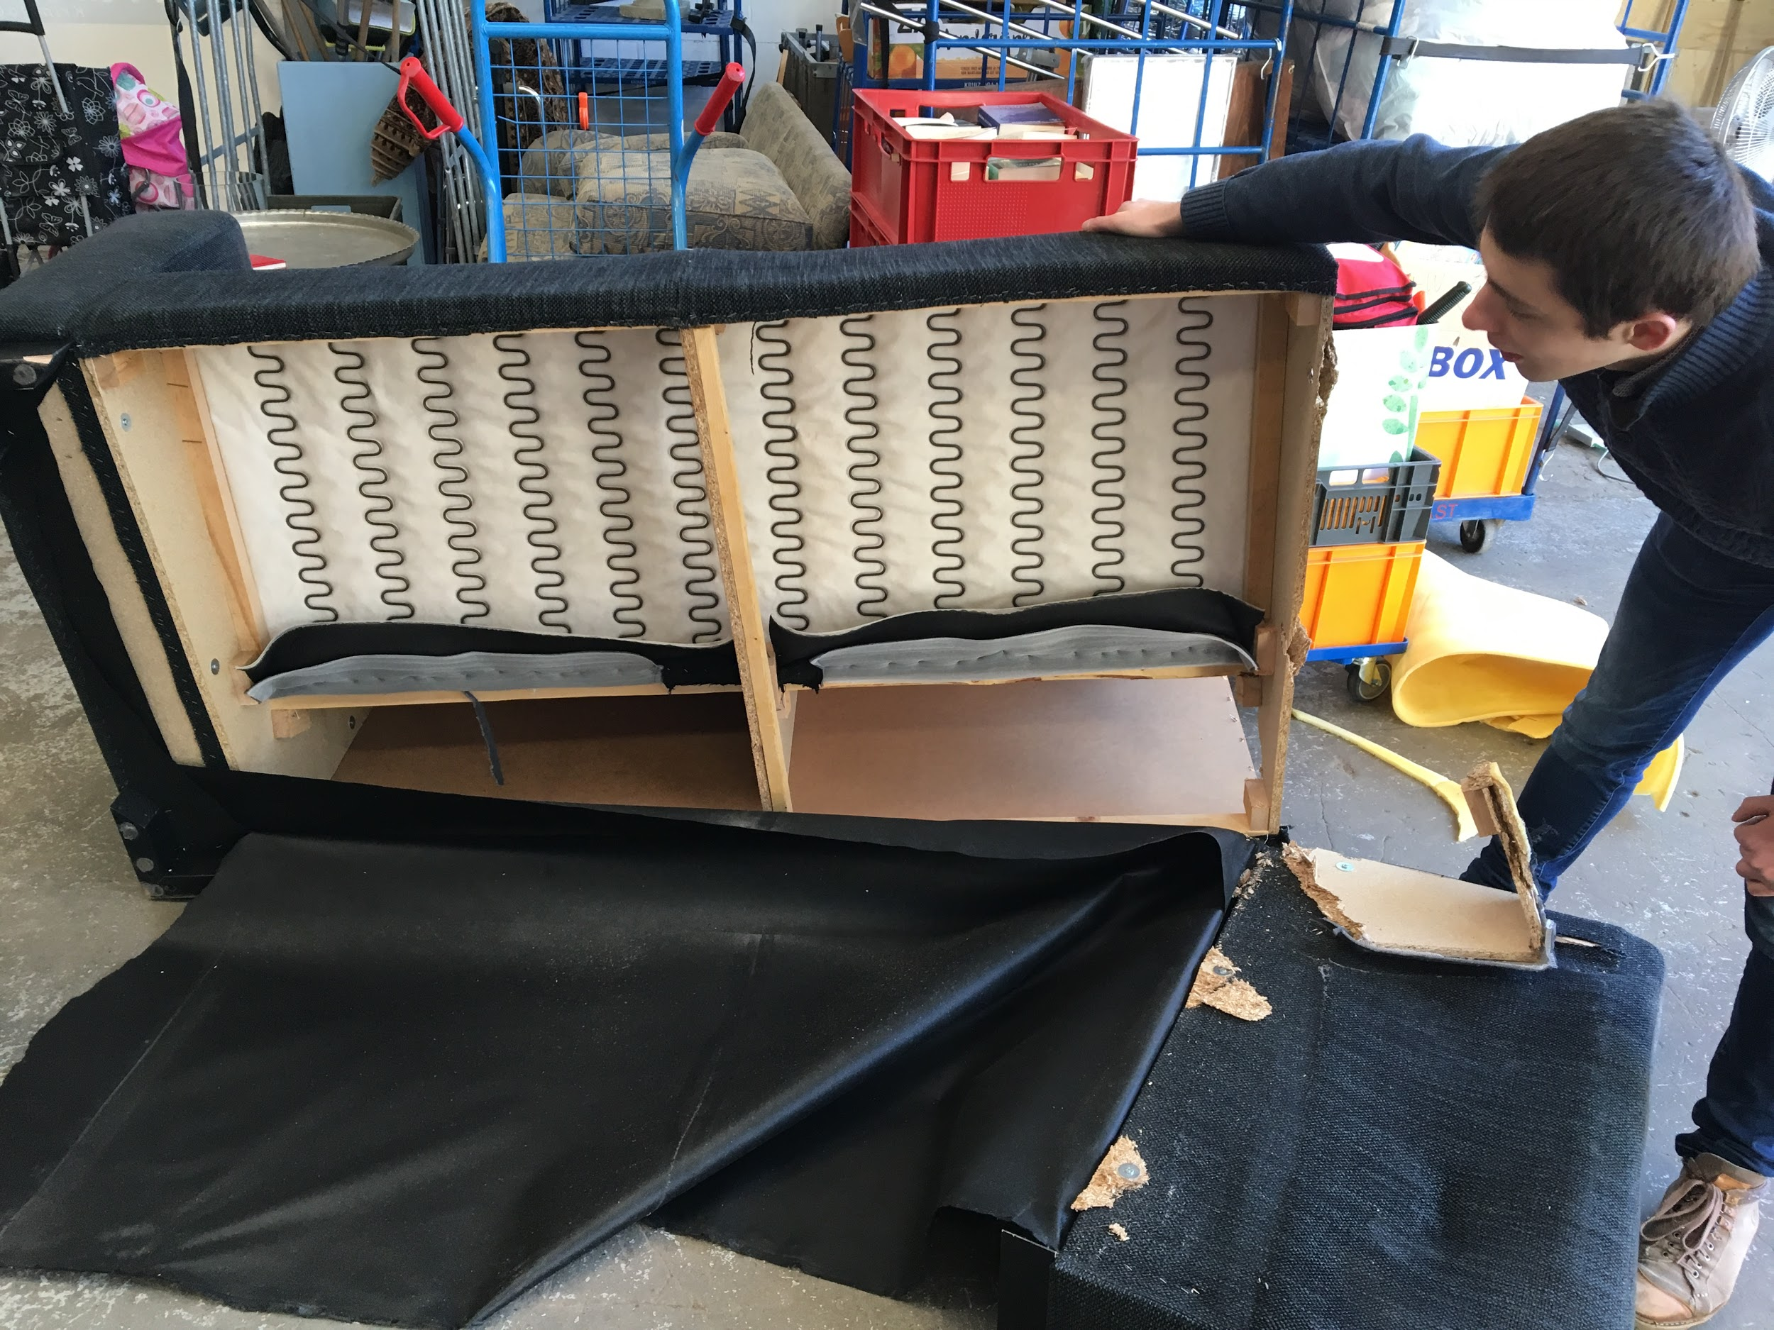
Wood: Numbers
1549 couches → 71,563 kg → 35,000~55,000 kg wood! [1,2]
This is B-quality wood, small size
Notes:
Sources:
Het Warenhuis Financial administration: Couches
Estimate: 50%-75% of couch weight comes from wood

Slide 28
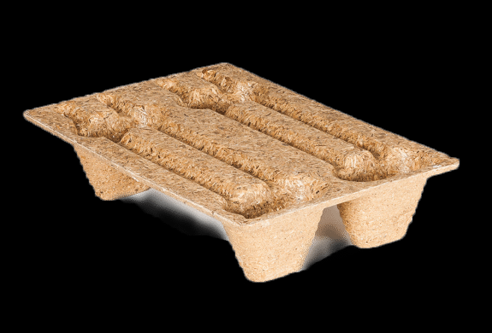
Wood: Recycling
Problem: shredding is only solution for large quantities
This is already done by most garbage collectors
B-quality wood costs money to get rid of [1,2,3,4]
Het Warenhuis pays €70 per 1000 kg for wood
Remember: mixed garbage is €145 per 1000 kg
→ Possibility of saving 50% on wood costs
Possible products that can be made
Plywood
Electricity
Pallets [5] →
Conclusion: no viable large quantity solution
Notes:
Sources:
https://www.containeronline.nl/afvalsoorten/houtafval/
https://www.renewi.com/nl-nl/zakelijk/soorten-afval/hout
https://www.afvalcontainerbestellen.nl/containers-huren/houtafval-containers/
https://www.zuidema-groep.nl/pagina/sloophout-afvalhout/
https://www.presswood.nl/
A lot of text

Slide 29
Foam: Recycling
Most foams are polyurethane foams
Assuming 10%-20% of couch mass is foam → 7,000~14,000 kg foam
Two main ways of recycling [1]
Mechanical
shredded into small pieces, used as filling
not used for old foam, because of smells, economics [4]
Chemical [1,2,3]
Not yet economical reliable, sometimes even technically unreliable
No large industrial opportunities yet
Sometimes still in research phase (example: NWO research proposal [3])
Conclusion: no viable large quantity solution
Notes:
Sources:
Wenqing Yang, Qingyin Dong, Shili Liu, Henghua Xie, Lili Liu, Jinhui Li, Recycling and Disposal Methods for Polyurethane Foam Wastes, Procedia Environmental Sciences, Volume 16, 2012, Pages 167-175, ISSN 1878-0296, https://doi.org/10.1016/j.proenv.2012.10.023.
D. Simón, A.M. Borreguero, A. de Lucas, J.F. Rodríguez, Recycling of polyurethanes from laboratory to industry, a journey towards the sustainability, Waste Management, Volume 76, 2018, Pages 147-171, ISSN 0956-053X, https://doi.org/10.1016/j.wasman.2018.03.041.
J.H.D. Voerman, PURPle PolyUrethaan Recycling Project, NWO Research Proposal, CE.01.065, https://www.nwo.nl/en/research-and-results/research-projects/i/44/28344.html.
Plastic Huis - Borduurshop Leiden, Lange Mare 57, Leiden. Informal talk with shop owner with over forty years of experience.
text amount!

Slide 30
Cover: Polyester + Cotton
Approximate cover weight: ~4.5 kg [5-13]
Content differs per couch; main materials
cotton [3,4]
polyester
Problem: Both can be recycled, but not at the same time
Innovation (2017): special liquid to dissolve cotton from polyester [1,2]
Notes:
Sources:
https://www.acs.org/content/acs/en/pressroom/newsreleases/2017/april/upcycling-fast-fashion-to-reduce-waste-and-pollution.html
Hou, W., Ling, C., Shi, S. et al. Fibers Polym (2018) 19: 742. https://doi-org.ezproxy.leidenuniv.nl:2443/10.1007/s12221-018-7735-9
http://saxcell.nl/
https://upsettextiles.com/how/
https://www.ikea.com/nl/nl/catalog/products/50348913/
https://www.ikea.com/nl/nl/catalog/products/30322320/
https://www.ikea.com/nl/nl/catalog/products/80413539/
https://www.ikea.com/nl/nl/catalog/products/40319237/
https://www.ikea.com/nl/nl/catalog/products/60306229/
https://www.ikea.com/nl/nl/catalog/products/S79255164/
https://www.ikea.com/nl/nl/catalog/products/50404367/
https://www.ikea.com/nl/nl/catalog/products/S99239620/
https://www.ikea.com/nl/nl/catalog/products/S79218261/

Slide 31
Polyester: Recycling
As a thermosetting or thermoplastic material, polyester is difficult to recycle: in the cover of couches mostly thermosetting
Can be recycled as part of the plastic recycling solution
Not contributing to mixed waste
Takes time to rightly separate polyester/deconstruct couches
Find a suitable company to collect the waste

Slide 32
Leather: Reusing
Small percentage of couches is leather: <20%
Leather can be sold in small parts (~per square foot):
€10 per square meter or €10-€20 per kilogram [1,2,3]
Used to make new products:
Label3 [4]
Upcycled [5]
Notes:
Sources (4/12/2019):
https://www.boomsma.nl/p/rundleer-lappen-assorti-grote-lappen%2C-grootte-min.-2-voet-per-kg-
https://echtleer.nl/product/restanten-leer/
http://leerlooier.nl/lederhandel-en-fournituren/lederwarenleder-tuigleder-en-afvalleder/
http://www.label3.nl/contact.html
https://upcycled.nl/over.html

Slide 33
Reusing: Small Quantities
Materials
Foam, wood and polyester
Large scale availability
Selling as hobby material
Tests should point out market potential
Inhouse woodshop
Educational opportunities for coworkers as woodworkers
Cover + foam
Gemiva?
Notes:
Additional Sources (where reusing wood in large quantities is useful)
http://www.vanoudhout.nl/
https://historischhout.nl/
https://oudeplank.nl/
https://www.barnwoodweb.nl/barnwood/
https://frankpouwer.nl/
Selling of scaffolding wood (common DIY-shops)

Slide 34
Finances 1
Assumptions for two-seat couch (gross estimates):
Cover weight ~4.5 kg
Separable wood 21-32 kg (=50%-75% of total couch weight)
Non separable waste (i.e. niche materials, foam) 6~17 kg
Costs and Fees [1,2]
Mixed garbage: -€145/1000kg
Wood: -€70/1000kg
Processing fee: +€112.15/1000kg
Notes:
Source:
Michael Spierenburg correspondence
Het Warenhuis Financial administration: Couches

Slide 35
Finances 2
Cost of couch processing, without labour cost (cost-mixed garbage):
Mixed garbage: -€6.16 (€0.00)
No cover + 21 kg wood: -€4.59 (+€1.57)
Cover + 21 kg wood: -€3.94 (+€2.23)
No cover + 32 kg wood: -€3.76 (+€2.40)
Cover + 32 kg wood: -€3.11 (+€3.05)
Reusing case without/with processing fee:
10 kg wood: +€0.70/+€1.82
10 kg mixed garbage (like foam/cover): +€1.45/+€2.57
Three-seat couch: Add ~18%
Notes:
Sources are in Finances 1.

Slide 36
Recognition
Educate workers LU associat. Social Media @HetWarenhuis

Slide 37
Recognition Through Education
Recognition of these findings by the people at the Warenhuis:
Sorting different materials (plastics) out of the mixed waste container based upon material knowledge
Deconstruction of couches into different material groups for either reusing purposes or recycling.
Recognition of circular furniture options among students
Social media page for Het Warenhuis to sell couches

Slide 38
Next Steps for Het Warenhuis: Implementing the 4R strategy

Slide 39
Step 1: Implement Paper Repurpose policy
Use the broken and/or damaged books that are found in the Paper container and repurpose them into paper bags. These can be used in the ‘Het Warenhuis’ store.
Advantages of repurposing paper:
Establishing a new material life cycle
Replacing plastic bags
Replacing price tags with reused paper
Lower price to pay for their ‘paper container’ (less weight)
Notes:
Source: http://www.plasticheroes.nl/

Slide 40
Step 2: Implement plastic Recycle Policy
Find a private player that offers recycling services for plastics, or team up with the municipality through the ‘Plastics Heroes’ initiative.
Keeping in mind that most companies require separation before collection, only some companies don’t require separation of plastics
Thermosetting
Thermoplastic
Elastomere
EPS (foams)
Initial quotations could be requested from the following companies:
Notes:
Source: http://www.plasticheroes.nl/

Slide 41
Options that offer mixed material collection
Renewi
Van Munster
Market leader, competitive prices
Small, medium and large containers
Good customer satisfaction rates
Large offer of services
Smaller player, no scale advantage
Small, medium and large containers
Many different services offered

Slide 42
Options that don’t offer mixed collection
Wastenet
Recycling.nl
Smaller player, no scale advantage
Small and large sized containers
Smaller player no scale advantage
Small and large sized containers
Limited customer satisfaction

Slide 43
Step 3: Implement 4R approach to couches
Reuse: If a couch can be cleaned, the aim should be to sell it
Repurpose: If some materials of the couch remain in good condition, by taking it apart we could repurpose these materials into creation of other products.
Recycle: If a couch’s condition or its materials do not pass a ‘reusing’ or ‘repurpose’ alternative (bad conditions), it can be dismantled and its parts recycled.
Recognition: An awareness campaign should be started among students using social media, and students that form part of Leiden University associations (e.g. OWL, Labyrinth, LUGO, etc.)

Slide 44
Step 4: Start educating employees
We will provide Het Warenhuis with a seminar to convey all the findings of this report in a practical and workable way for the people who have to carry out these policies.
Knowledge of the different materials is key and will be, in collaboration with the recycling company, shared with the employees
A sense of purpose of all these measures should be conveyed, making the importance of the direct circular and sustainable impact of the work of employees clear, in combination with the financial benefits of the policies

Slide 45
Conclusions & Recommendations

Slide 46
Concluding recommendations
Putting this 4R advice into practice could yield real results as explained and calculated in this research, it should therefore be implemented whenever the management and employees are ready to do so
While implementing it data collection is of key importance to be able to evidence based evaluate the effectiveness of the policy
Education plays a crucial role in making the implementation of this policy a success, only after there is knowledge about and support for the policy it should be implemented
Continuous efforts should be put into the marketing and communication campaigns towards students

